Slide 1
Halliday & Resnick’s
Fundamentals of Physics
Extended Edition Wiley
Jearl Walker
Chapter 16
Waves-I

Slide 2
16.2 Types of Waves
Mechanical waves. These waves have two central features: They are governed by Newton’s laws, and they can exist only within a material medium, such as water, air, etc. Common examples include water waves, sound waves, and seismic waves.
Electromagnetic waves. waves. These waves require no material medium to exist. All electromagnetic waves travel through a vacuum at the same exact speed c= 299,792,458 m/s. Common examples include visible and ultraviolet light, radio and television waves, microwaves, x rays, and radar.
Matter waves. These waves are associated with electrons, protons, and other fundamental particles, and even atoms and molecules. These waves are also called matter waves.

Slide 3
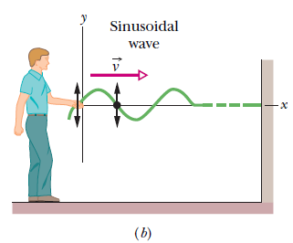
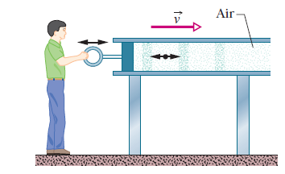
16.3 Transverse and Longitudinal Waves
In a transverse wave, the displacement of every such oscillating element along the wave is perpendicular to the direction of travel of the wave, as indicated in Fig. 16-1.
In a longitudinal wave the motion of
the oscillating particles is parallel to the direction of the wave’s travel, as shown in Fig. 16-2.

Slide 4
A wave sent along a stretched, taut string is the simplest mechanical wave. If you give one end of a stretched string a single up-and-down jerk, a wave in the form
of a single pulse travels along the string. This pulse and its motion can occur because the string is under tension.
When you pull your end of the string upward, it begins to pull upward on the adjacent section of the string via tension between the two sections. As the adjacent section moves upward, it begins to pull the next section upward, and so on.
The net result is that a distortion in the string’s shape moves along the string at some velocity v
Transverse Wave & SHM
If you move your hand up and down in continuous simple harmonic motion, a
continuous wave travels along the string at velocity. Because the motion of your
hand is a sinusoidal function of time, the wave has a sinusoidal shape at any given instant; that is, the wave has the shape of a sine curve or a cosine curve.
We consider here only an “ideal” string, in which no friction-like forces
within the string cause the wave to die out as it travels along the string.

Slide 5
Longitudinal Wave & SHM
Figure shows how a sound wave can be produced
by a piston in a long, air-filled pipe.
If you suddenly move the piston rightward and then leftward, you can send a pulse of sound along the pipe.
The rightward motion of the piston moves the elements of air next to it rightward, changing the air pressure there. The increased air pressure then pushes rightward on the elements of air somewhat farther along the pipe.
Moving the piston leftward reduces the air pressure next to it. As a result, first the elements nearest the piston and then farther elements move leftward.
Thus, the motion of the air and the change in air pressure travel rightward along the pipe as a pulse.
If you push and pull on the piston in simple harmonic motion, as is being
done in Fig., a sinusoidal wave travels along the pipe. Because the motion of the elements of air is parallel to the direction of the wave’s travel, the motion is said to be longitudinal, and the wave is said to be a longitudinal wave.

Slide 6
Traveling Wave
Both a transverse wave and a longitudinal wave are said to be traveling waves because they both travel from one point to another, as from one end of the string to the other end and from one end of the pipe to the other end.
Note that it is the wave that moves from end to end, not the material (string or air) through which the wave moves.

Slide 7
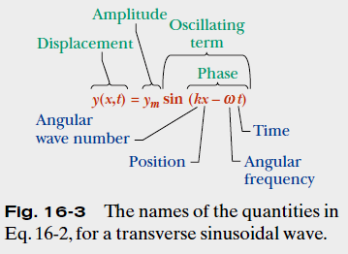
16.4 Wave variables

Slide 8




16.4 Wave variables
The amplitude y_{m} of a wave is the magnitude of the maximum displacement of the elements from their equilibrium positions as the
wave passes through them.
The phase of the wave is the argument (kx –ωt) of the sine function. As the wave sweeps through a string element at a particular position x, the phase changes linearly with time t.
The wavelength λ of a wave is the distance parallel to the direction of the wave’s
travel) between repetitions of the shape of the wave (or wave shape). It is related to the angular wave number, k, by
:
The period of oscillation T of a wave is the time for an element to move through one full oscillation. It is related to the angular frequency, ω, by
The frequency f of a wave is defined as 1/T and is related to the angular frequency ω by
A phase constant φ in the wave function:
y =y_{m} sin(kx –ωt+ φ). The value of φ can be chosen so that the function gives some other displacement and slope at x 0 when t 0.

Slide 9
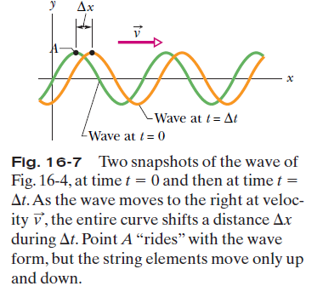

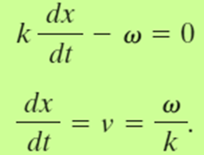

16.4 The Speed of a Traveling Wave
As the wave in Fig. 16-7 moves, each point of the moving wave form, such as point A marked on a peak, retains its displacement y. (Points on the string do not retain their displacement, but points on the wave form do.) If point A retains its displacement as it moves, the phase giving it that displacement must
remain a constant:

Slide 10
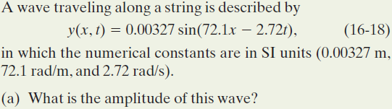
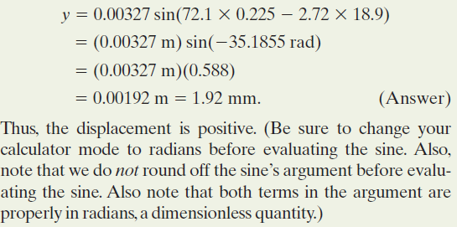
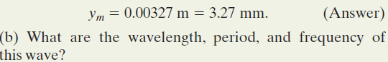
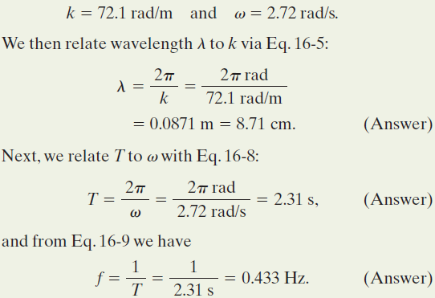

Example, Transverse Wave

Slide 11
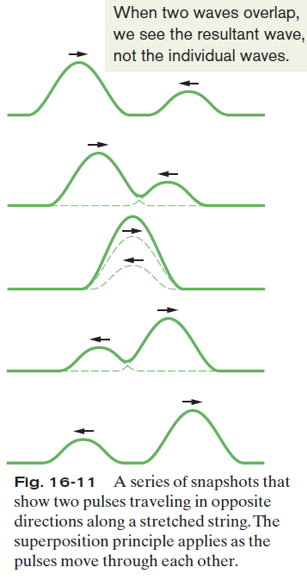

16.9: The Superposition of Waves
Overlapping waves algebraically add to produce a resultant wave (or net wave).
Overlapping waves do not in any way alter the travel of each other.

Slide 12



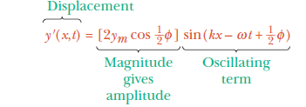
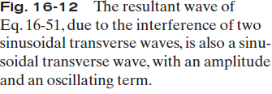
16.9: Interference of Waves
If two sinusoidal waves of the same amplitude and wavelength travel in the same direction along a stretched string, they interfere to produce a resultant sinusoidal wave traveling in that direction.

Slide 13
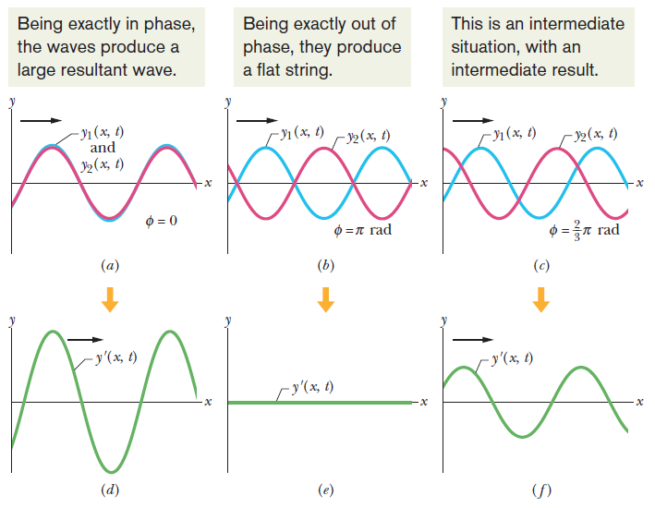
16.9: Interference of Waves

Slide 14
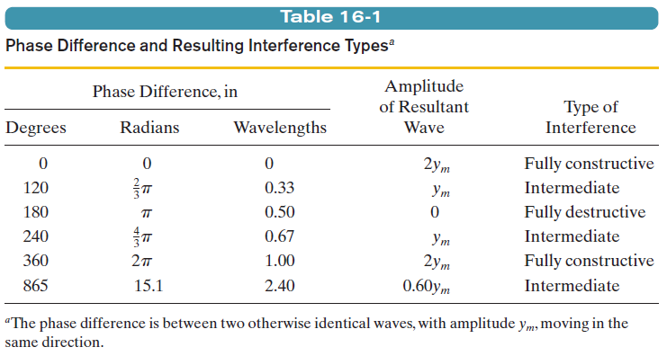
16.9: Interference of Waves

Slide 15
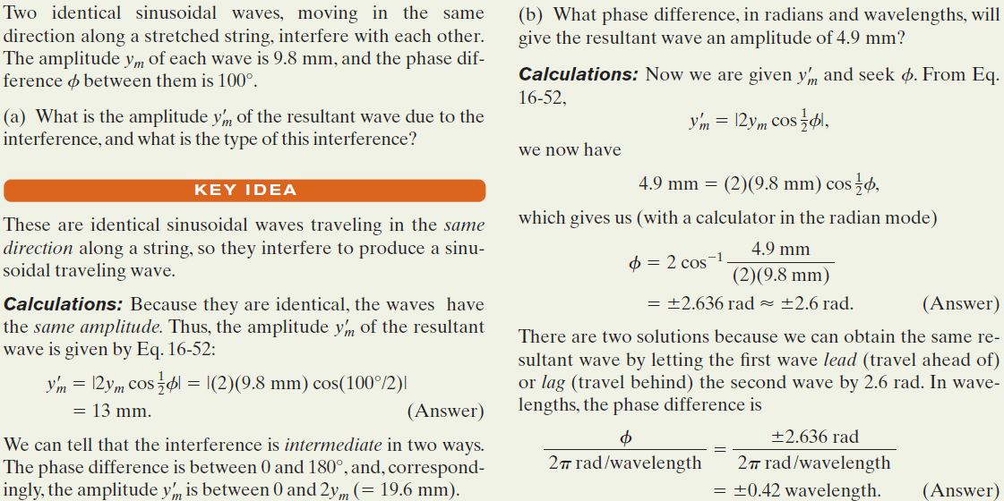
Example, Transverse Wave:

